Slide 1
How does carbon sequestration from natural forest regrowth differ around the world?
Notes:
Ask students for input and predictions (not necessarily hypotheses yet)

Slide 2
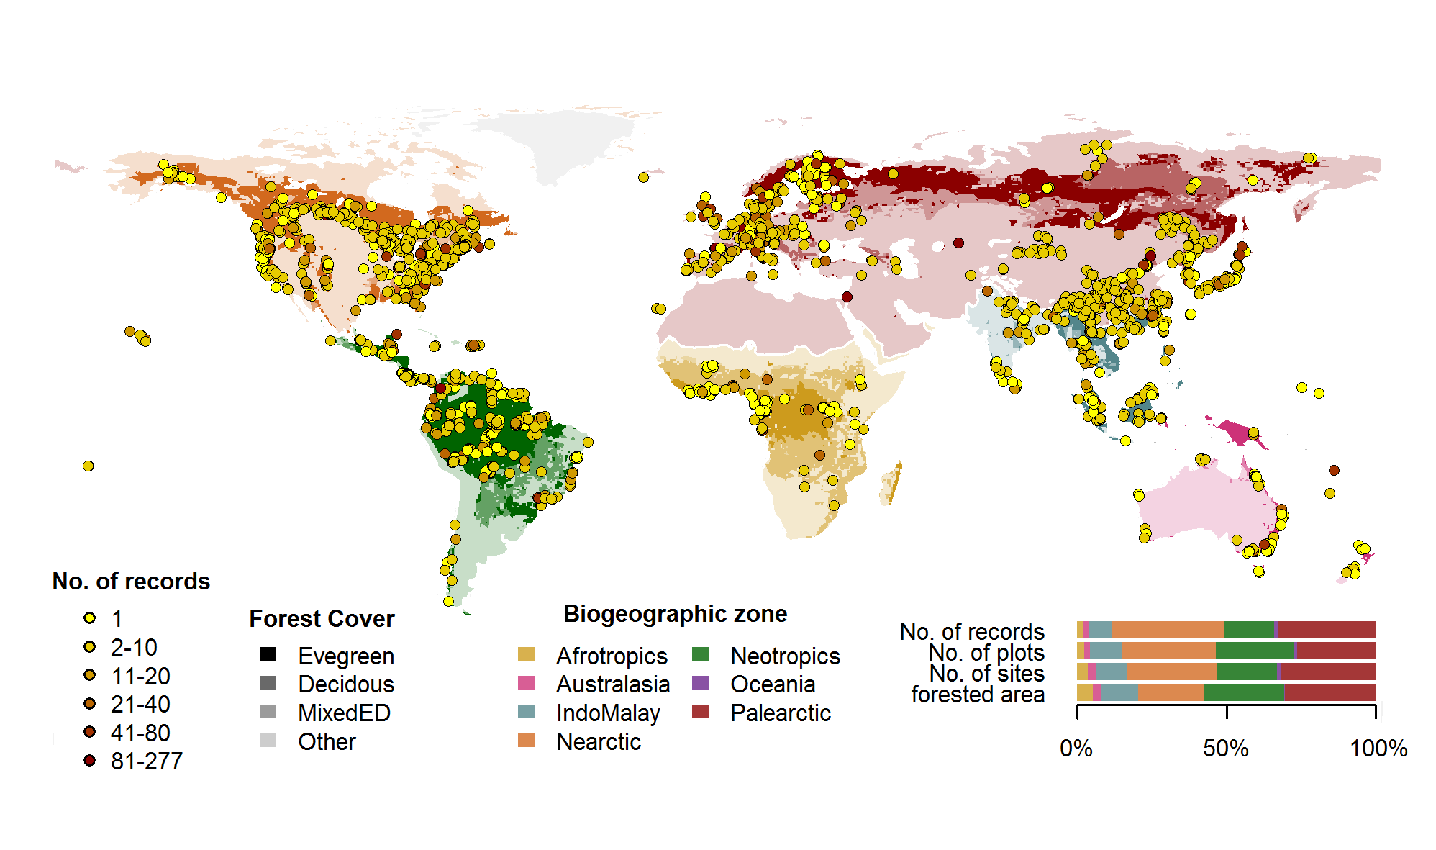
ForC Records
Notes:
This contains the ForC databases from around the world. Students will be working with data from different locations (https://forc-db.github.io/)

Slide 3
A Year in the Life of Earth’s CO2
Before the video begins predict what will happen to Earth’s carbon dioxide concentrations over the course of a year.
What happens to the carbon dioxide emitted from fossil fuel combustion? Where does it go?
Watch the video carefully and write down quick notes on what you’re seeing as the year progresses. Note months with high and low concentrations. Write down as many observations as you can. Be sure to write down any major changes or anything you hear that is surprising.
What is happening to the concentrations of carbon dioxide in the air?
Notes:
https://svs.gsfc.nasa.gov/cgi-bin/details.cgi?aid=11719
This is an opportunity to discuss carbon sequestration and climate change

Slide 4
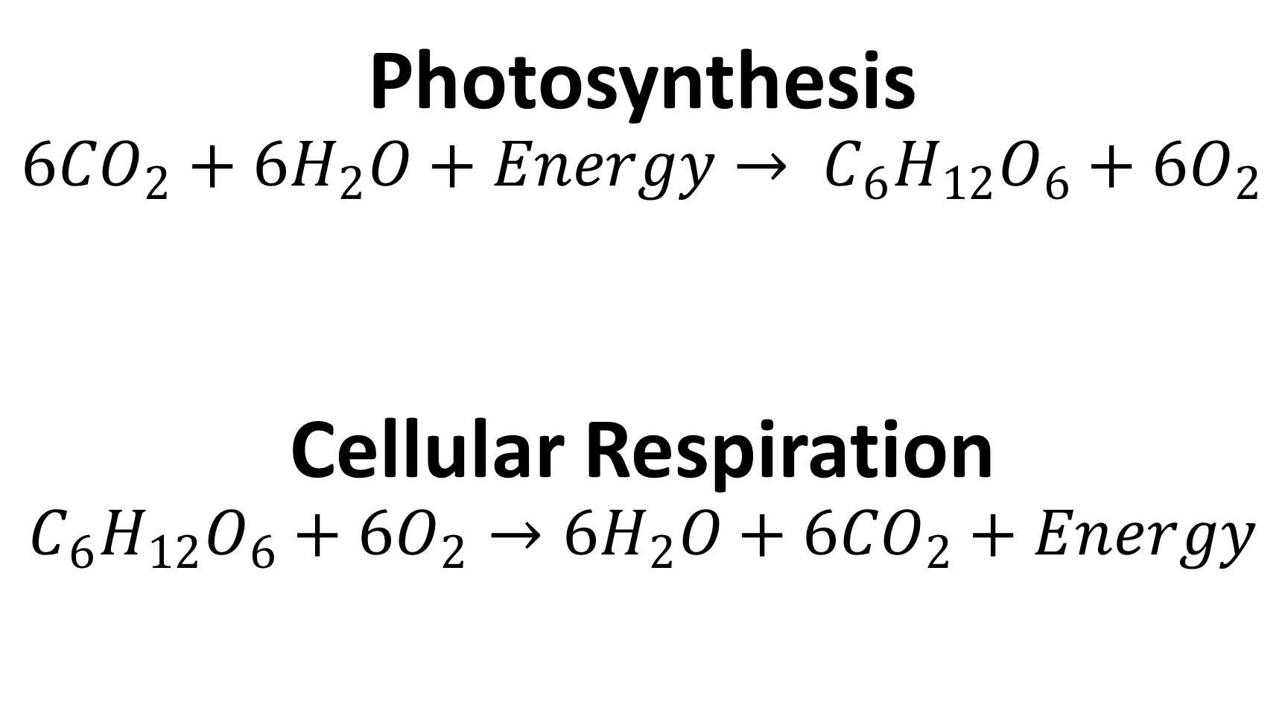
Photosynthesis
$$6{CO}_{2}+{6H}_{2}O+Energy→ C_{6}H_{12}O_{6}+6O_{2}$$
Cellular Respiration
$$C_{6}H_{12}O_{6}+6O_{2}→{6H}_{2}O+6{CO}_{2}+Energy$$
Notes:
Review the formulas for photosynthesis and cellular respiration, make sure to discuss their connections

Slide 5
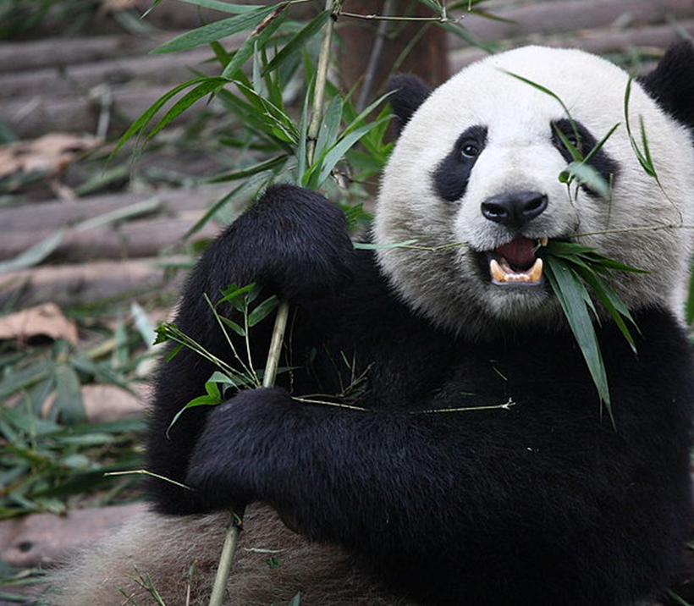
Biological Carbon Cycle
Carbon enters all food webs, both terrestrial and aquatic, through autotrophs (usually through photosynthesis)
Heterotrophs consume the organic molecules, and the organic carbon is passed through food chains and webs.
Carbon is released back into the atmosphere through cellular respiration
Producers, Consumers, Decomposers
Notes:
Carbon can cycle quickly through this biological pathway, especially in aquatic ecosystems. Overall, an estimated 1,000 to 100,000 million metric tons of carbon move through the biological pathway each year. For context, a metric ton is about the weight of an elephant or a small car
(photo - https://commons.wikimedia.org/wiki/File:Giant_Panda_Eating.jpg, by Chen Wu from Shanghai, China)

Slide 6
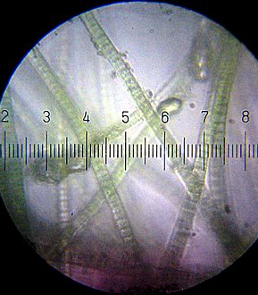
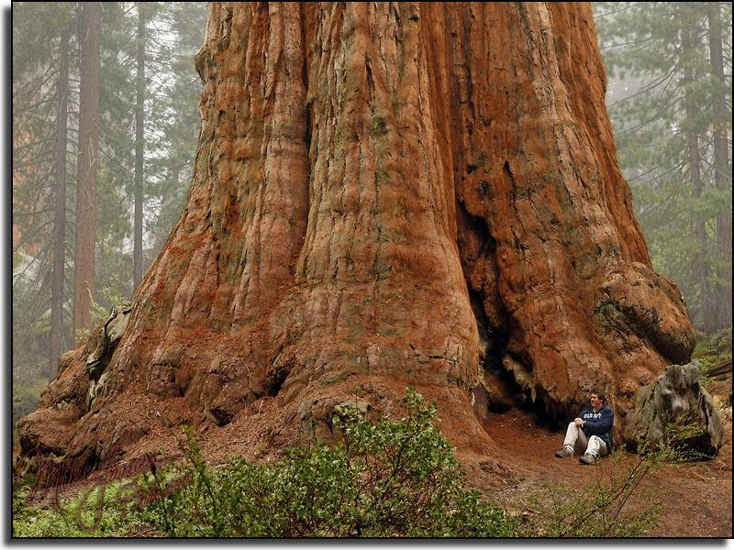
Carbon fixation: the conversion of inorganic carbon (carbon dioxide) to organic compounds by living organisms
Carbon sequestration: a natural or artificial process where carbon dioxide is removed from the atmosphere and held in solid or liquid form.
Notes:
Photos curtesy of Wikipedia commons, basic difference between carbon fixation (the algae) and carbon sequestration (the giant redwood)

Slide 7
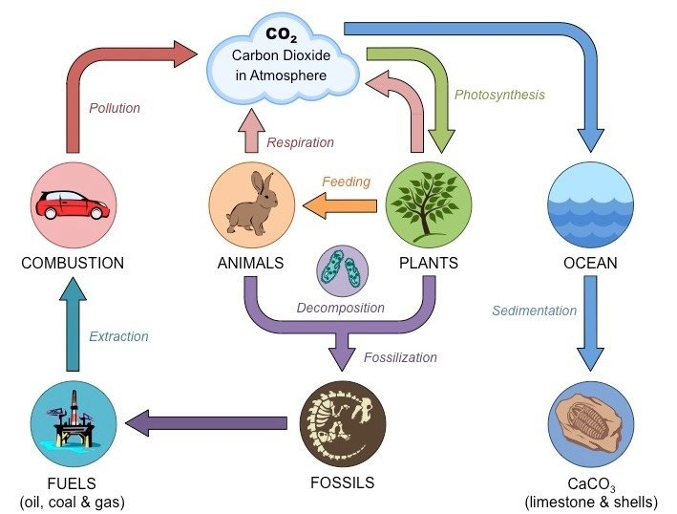
Notes:
Ask for input on the carbon cycle, review the basic process of global warming (where Carbon Dioxide in the atmosphere traps heat causing the global temperature to rise)
(photo credit - https://www.noaa.gov/education/resource-collections/climate/carbon-cycle)

Slide 8
Notes:
This shows fluctuations in carbon stocks. Note that most carbon is cycled through the forest and a small percentage overall is actually put into the forest sink. A negative number means carbon is being pulled from the atmosphere and a positive number means it’s being released.
(photo credit – painting by Kristina Anderson-Teixeira, text by Valentine Hermann)

Slide 9
ForC: The Forest Carbon database
ForC is an open-access database containing over 29,713 records from 4,971 plots in 3,325 geographically distinct areas.
All data in ForC comes from published research by accredited scientists.
This database covers all forested biogeographic and climate zones
ForC can be used for ecological analysis of forest carbon cycling, evaluating models and remote sensing, and supporting international efforst to inventory forest carbon and greenhouse gas exchange.

Slide 10
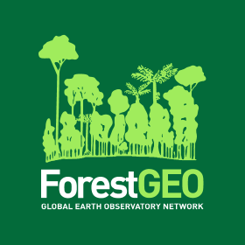
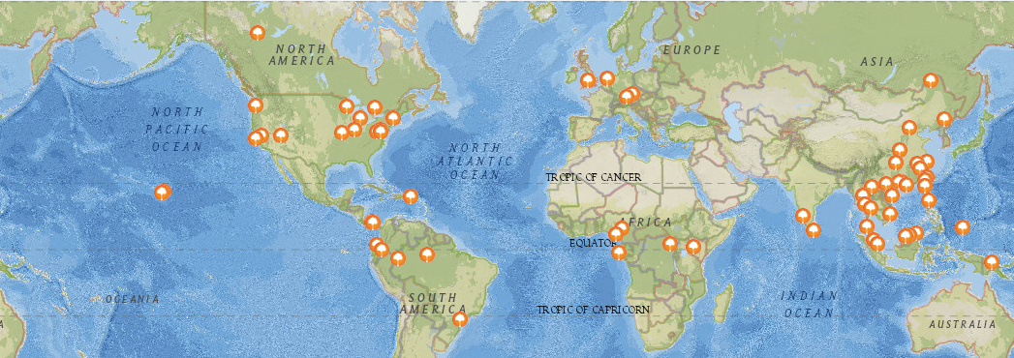
The Forest Global Earth Observatory (ForestGEO), previously known as Center for Tropical Forest Science (CTFS), is a global network of forest research sites and scientists dedicated to the study of tropical and temperate forest function and diversity.
The multi-institutional network comprises 66 forest research sites across the Americas, Africa, Asia, Europe, and Oceania
ForestGEO monitors the growth and survival of approximately 6 million trees and nearly 13,000 species that occur in the forest research sites.
A map of all ForestGEO sites
Notes:
https://forestgeo.si.edu/

Slide 11
(place holder!)
Notes:
Slides on forest regrowth

Slide 12
Place holder
Notes:
Slides on IPCC

Slide 13
Place holder
Notes:
Go into study

Slide 14
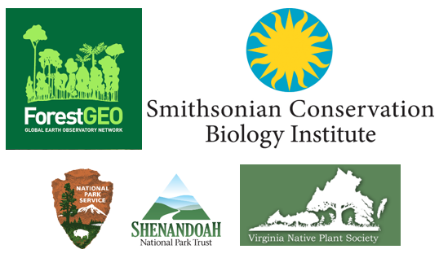
Acknowledgements
Co-authors: Ryan Helcoski, Kristin Black, Kristina Anderson-Teixeira
We would like to thank the following organizations for providing funding to make this endeavor possible

